Slide 1
Big Data Analytics 2023 Module 6.3 Big Data Applications
Recommendation Systems

Slide 2
Overview
Recommendation Systems
A Model for Recommendation Systems
Content Based Recommendations
Collaborative Filtering

Slide 3
Difficulties of Making Decision
Which digital camera should I buy?
Where should I spend my holiday?
Which movie should I rent?
Whom should I follow?
Where should I find interesting news article?
Which holiday destination is the best for our family?

Slide 4
Common Solutions to the Problem
Consulting friends
Obtaining information from a trusted third party
Hiring a team of experts
Search the Internet
Following the crowd (pick the item from top-n lists, e.g., best sellers on Amazon)
Can we automate all of the above?
Using a recommender algorithm
Goal of Recommendation:
To come up with a short list of
items that fits user’s interests

Slide 5
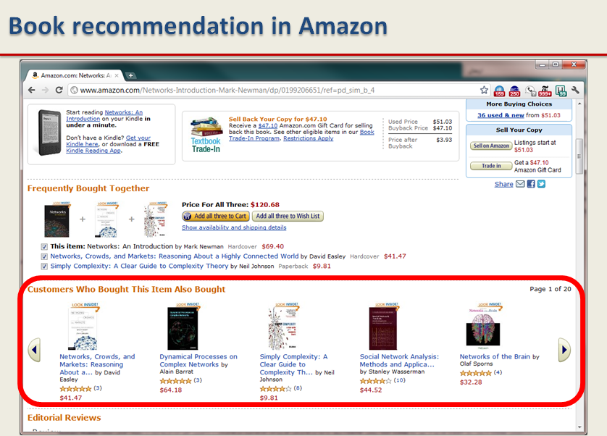
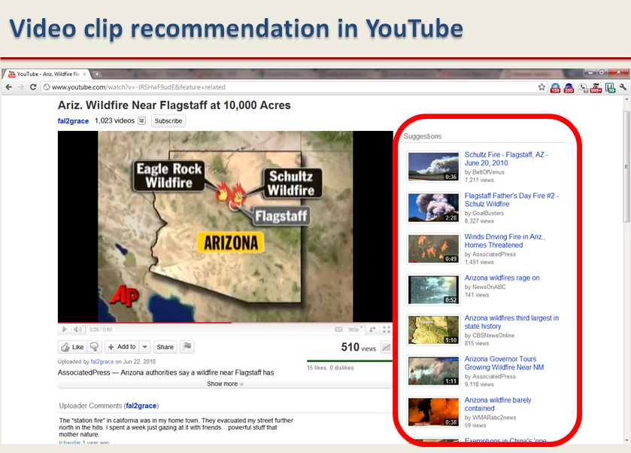
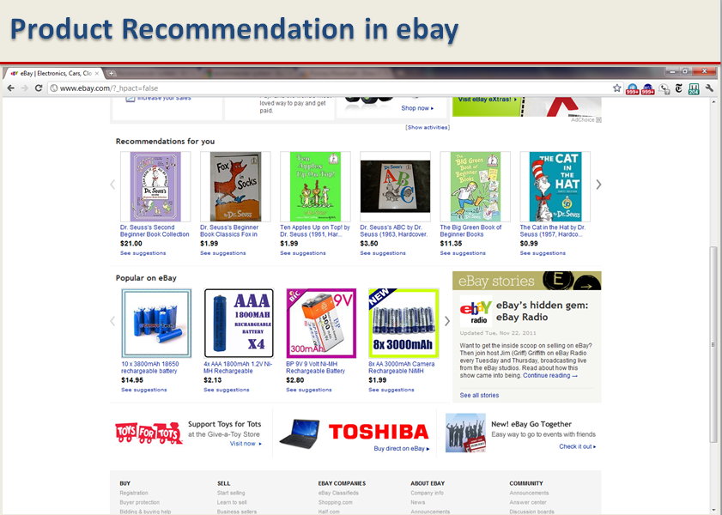
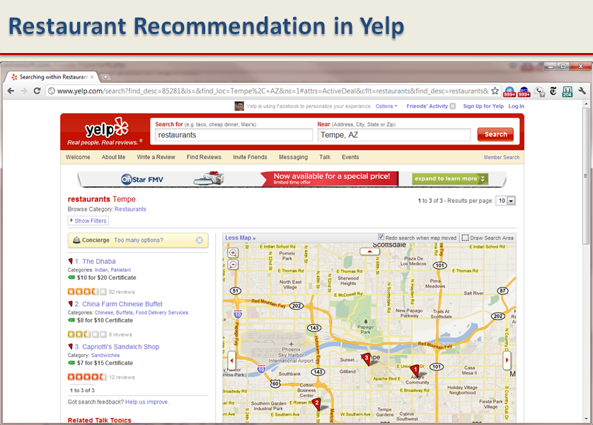
Recommender Systems - Examples

Slide 6
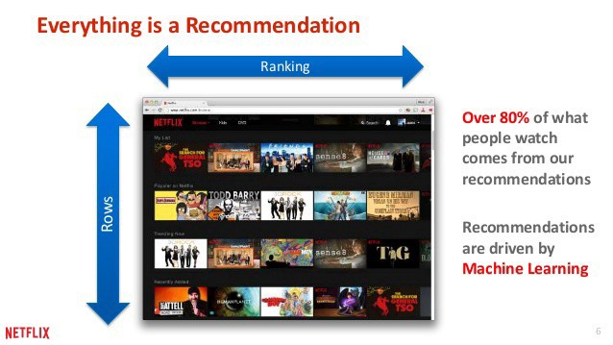

Slide 7
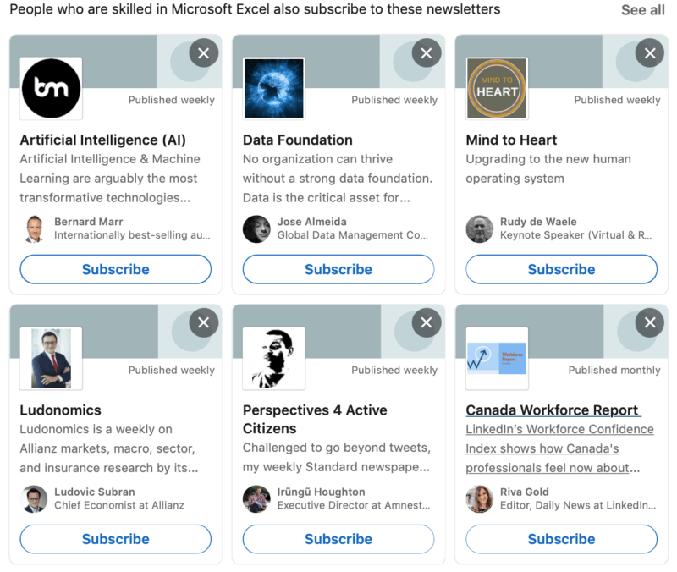

Slide 8
Main Idea behind Recommender Systems
Use historical data such as the user’s past preferences or similar users’ past preferences to predict future likes
Users’ preferences are likely to remain stable, and change smoothly over time.
By watching the past users’ or groups’ preferences, we try to predict their future likes
Then we can recommend items of interest to them
Formally, a recommender system takes a set of users U and a set of items I and learns a function f such that:

Slide 9
Recommendation vs. Search
Search engines find results that match the query provided by the user
The results are generally provided as a list ordered with respect to the relevance of the item to the given query
Consider the query “best 2021 movie to watch”
Search engines’ results are not customized
The same results for an 8 year old and an adult

Slide 10










Recommendations
Examples:
Search
Recommendations
Items
Products, web sites, blogs, news items, …

Slide 11
Types of Recommendations
Editorial and hand curated
List of favorites
Lists of “essential” items
Simple aggregates
Top 10, Most Popular, Recent Uploads
Tailored to individual users
Amazon, Netflix, …

Slide 12
Formal Model
X = set of Customers
S = set of Items
Utility function u: X × S → R
R = set of ratings
R is a totally ordered set
e.g., 0-5 stars, real number in [0,1]

Slide 13
Utility Matrix
 | Sholay | Tiger | Avengers | StarWar
Anita | 1 |  | o.2
Balu |  | 0.5 |  | 0.3
Chirag | 0.2 |  | 1
Divya |  |  |  | 0.4

Slide 14
Key Problems
(1) Gathering “known” ratings for matrix
How to collect the data in the utility matrix
(2) Extrapolate unknown ratings from the known ones
Mainly interested in high unknown ratings
We are not interested in knowing what you don’t like but what you like
(3) Evaluating extrapolation methods
How to measure success/performance of recommendation methods

Slide 15
(1) Gathering Ratings
Explicit
Ask people to rate items
Doesn’t work well in practice – people can’t be bothered
Implicit
Learn ratings from user actions
E.g., purchase implies high rating
What about low ratings?

Slide 16
(2) Extrapolating Utilities
Key problems:
Data Sparsity:
Utility matrix U is sparse
Most people have not rated most items
Cold start:
New items have no ratings
New users have no history

Slide 17
(3) Other Challenges
Attacks
Push Attack: pushing the ratings up by creating fake users
Nuke attack: DDoS attacks, stop the whole recommendation systems
Privacy
Employing user’s private information to recommend to others.
Explanation
Recommendation systems often recommend items without any explanation of why recommending them

Slide 18
Types of Recommendation Systems
Content Based Recommendation Systems
Recommendations are based on information on the content of items rather than on other users’ opinions.
Uses machine learning algorithms to induce a profile of the users preferences from examples based on a featural description of content.
Collaborative Filtering
For a given user, find other similar users whose ratings strongly correlate with the current user.
Recommend items rated highly by these similar users, but not rated by the current user.

Slide 19
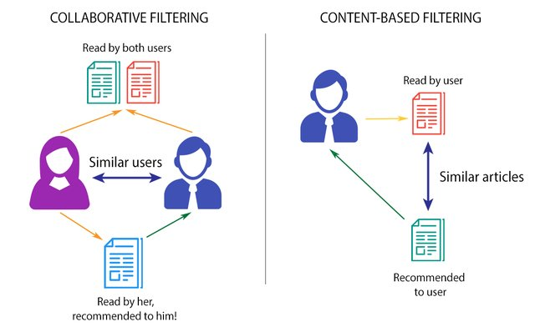
Content-based vs. Collaborative Filtering

Slide 20
Content-based Recommender Systems

Slide 21
Content-Based Methods
Based on the fact that a user’s interest should match the description of the items that she should be recommended by the system.
The more similar the item’s description to that of the user’s interest, the more likely that the user finds the item’s recommendation interesting.
Finding the similarity between the user and all of the existing items is the core of this type of recommender systems

Slide 22
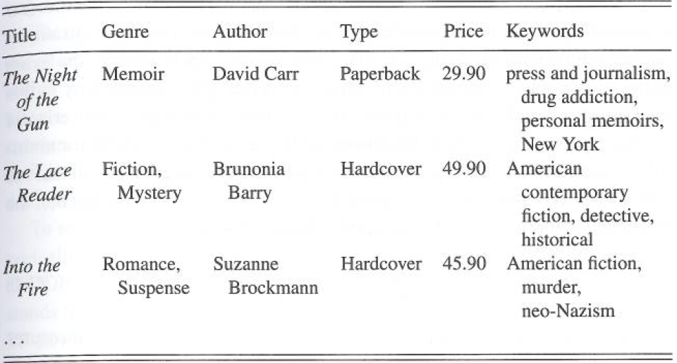
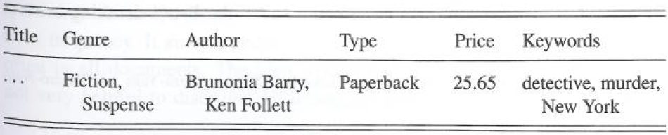
Content-based Recommendation: An Example
Book knowledge base
User Profile

Slide 23
Algorithm
Describe the items to be recommended
Create a profile of the user that describes the types of items the user likes
Compare items with the user profile to determine what to recommend
The profile is often created, and updated automatically in response to feedback on the desirability of items that are presented to the user

Slide 24
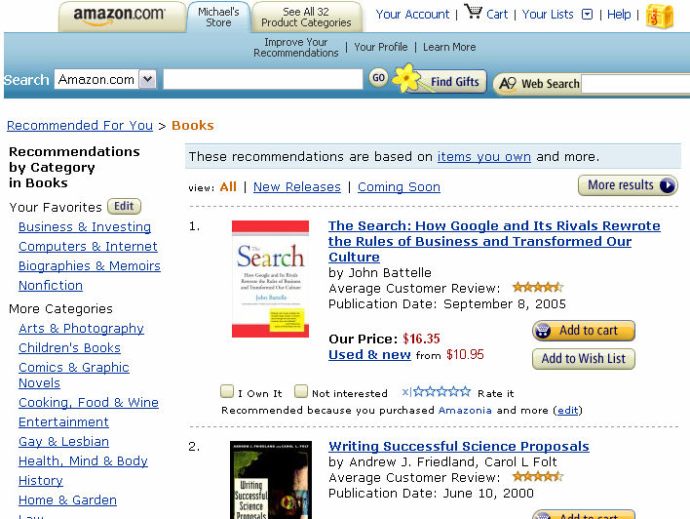
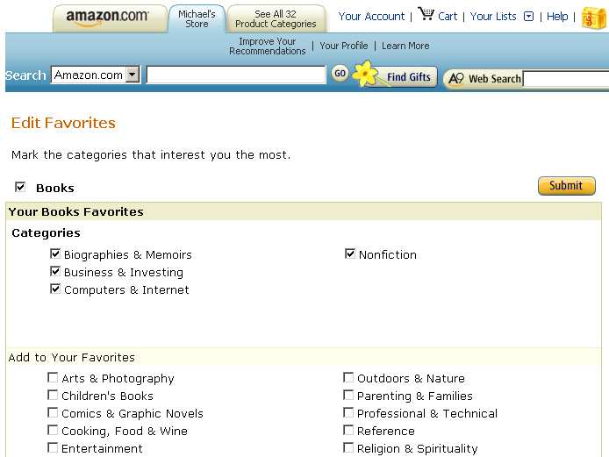
Example
Notes:
Left panel is user profile (or model), right panel is the recommendation result used the user profile.

Slide 25
Content-Based Methods
To formalize a content-based method, we first represent both user profiles and item descriptions by vectorizing them using a set of k keywords
We can vectorize (e.g., using TF-IDF) both users and items and compute their similarity
We can recommend the top most similar items to the user

Slide 26
Content-based Recommendations
Main idea: Recommend items to customer x similar to previous items rated highly by x
Example:
Movie recommendations
Recommend movies with same actor(s), director, genre, …
Websites, blogs, news
Recommend other sites with “similar” content

Slide 27
Plan of Action
Item profiles
likes
build
recommend
match
Red
Circles
Triangles
User profile

Slide 28
Item Profiles
For each item, create an item profile
Profile is a set (vector) of features
Movies: author, title, actor, director,…
Text: Set of “important” words in document
How to pick important features?
Usual heuristic from text mining is TF-IDF (Term frequency * Inverse Doc Frequency)
Term … Feature
Document … Item

Slide 29
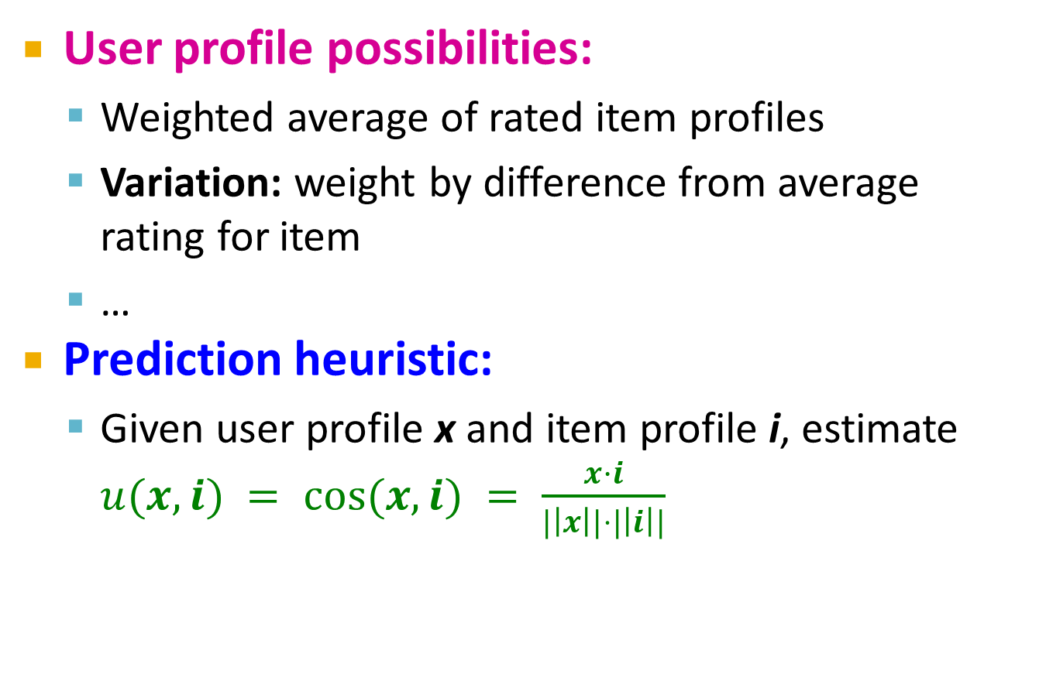
User Profiles and Prediction
User profile possibilities:
Weighted average of rated item profiles
Variation: weight by difference from average rating for item
…
Prediction heuristic:
Given user profile x and item profile i, estimate $u(x,i) = cos⁡(x,i) = \frac{x·i}{|\left|x\right||⋅|\left|i\right||}$

Slide 30
Algorithm
In content-based recommendation, we compute the topmost similar items to a user j and then recommend these items in the order of similarity

Slide 31
Pros: Content-based Approach
+: No need for data on other users
No cold-start or sparsity problems
+: Able to recommend to users with unique tastes
+: Able to recommend new & unpopular items
No first-rater problem
+: Able to provide explanations
Can provide explanations of recommended items by listing content-features that caused an item to be recommended

Slide 32
Cons: Content-based Approach
–: Finding the appropriate features is hard
E.g., images, movies, music
–: Recommendations for new users
How to build a user profile?
–: Overspecialization
Never recommends items outside user’s content profile
People might have multiple interests
Unable to exploit quality judgments of other users

Slide 33
LIBRA Learning Intelligent Book Recommending Agent
Content-based recommender for books using information about titles extracted from Amazon.
Uses information extraction from the web to organize text into fields:
Author
Title
Editorial Reviews
Customer Comments
Subject terms
Related authors
Related titles

Slide 34
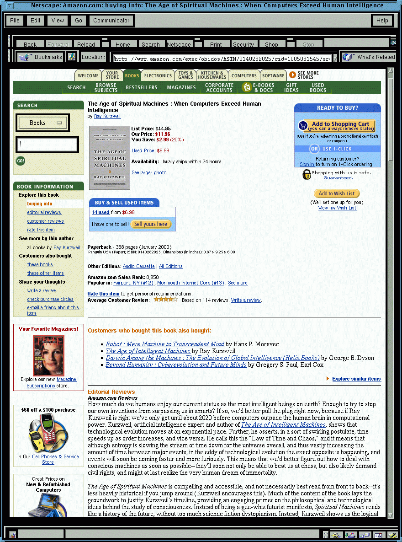
LIBRA System
Amazon Pages
LIBRA Database
Information
Extraction
Rated
Examples
Machine Learning
Learner
Recommendations
1.~~~~~~
2.~~~~~~~
3.~~~~~
:
:
:
User Profile
Predictor

Slide 35
Collaborative Filtering
Harnessing quality judgments of other users

Slide 36
Collaborative Filtering
Collaborative filtering is the process of selecting information or patterns using techniques involving collaboration among multiple agents, viewpoints, data sources, etc.
The main advantage of this method is that the recommender system does not need to have additional information about the users or content of the items
Users’ rating or purchase history is the only information that is needed to work

Slide 37
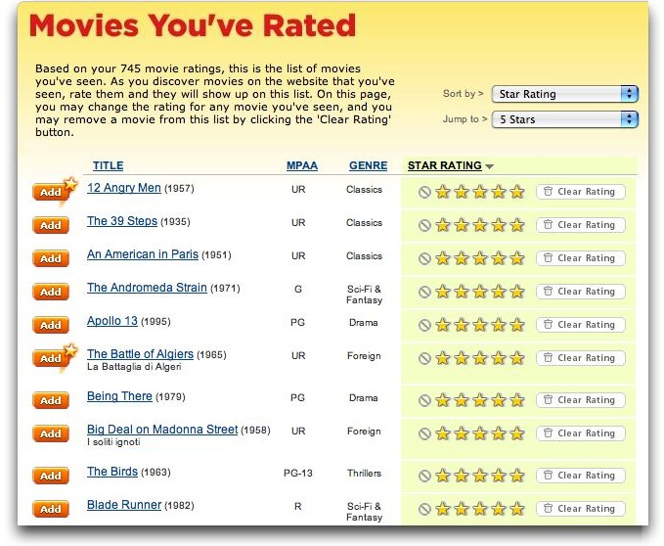
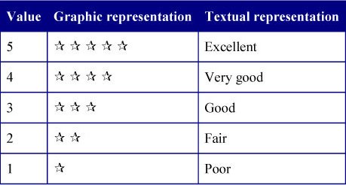
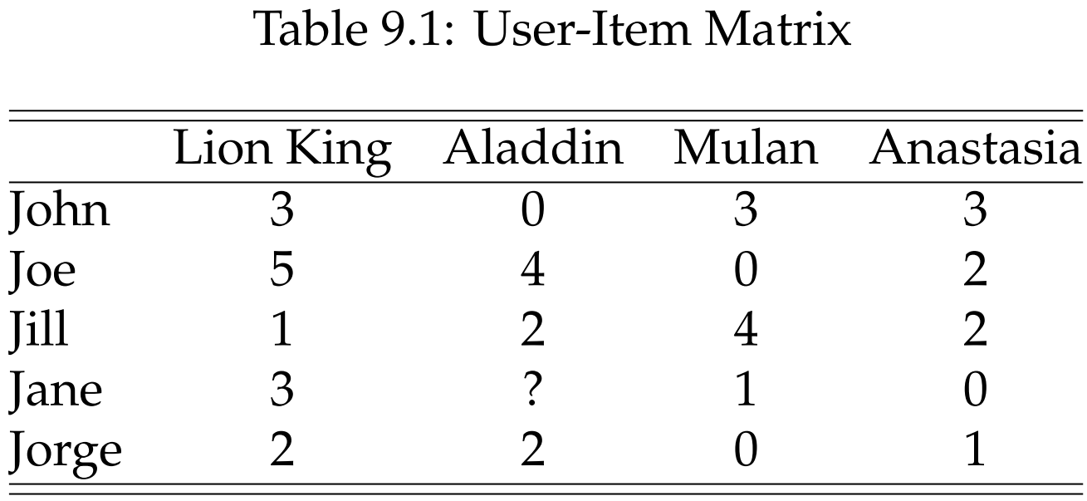
Rating Matrix: An Example

Slide 38
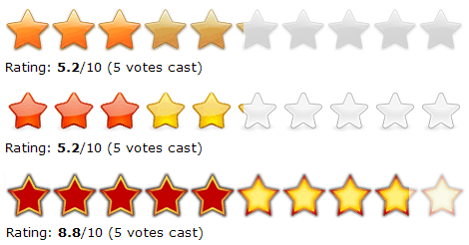
Rating Matrix
Users rate (rank) the items (purchased, watched)
Explicit ratings: entered by a user directly
(i.e., “Please rate this on a scale of 1-5”)
Implicit ratings: inferred from other user behavior
Play lists or music listened to, for a music Rec system
The amount of time users spent on a webpage

Slide 39
Collaborative Filtering
Types of Collaborative Filtering Algorithms:
Memory-based: Recommendation is directly based on previous ratings in the stored matrix that describes user-item relations
Model-based: Alternatively, one can assume that an underlying model (hypothesis) governs the way users rate items. This model can be approximated and learned. The model is then used to recommend ratings. A model, for example, is that users rate low budget movies poorly

Slide 40
Memory-Based Collaborative Filtering
User-based CF
Users with similar previous ratings for items are likely to rate future items similarly
Item-based CF
Items that have received similar ratings previously from users are likely to receive similar ratings from future users

Slide 41
Collaborative Filtering: Algorithm
Weigh all users/items with respect to their similarity with the current user/item
Select a subset of the users/items (neighbors) as recommenders
Predict the rating of the user for specific items using neighbors’ ratings for the same (or similar) items
Recommend items with the highest predicted rank

Slide 42
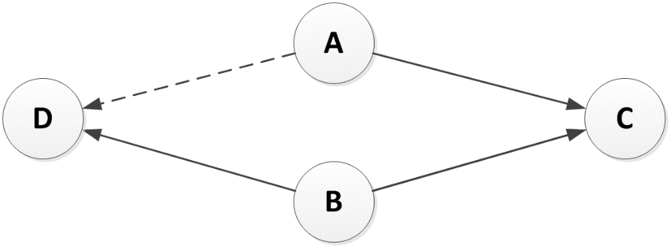
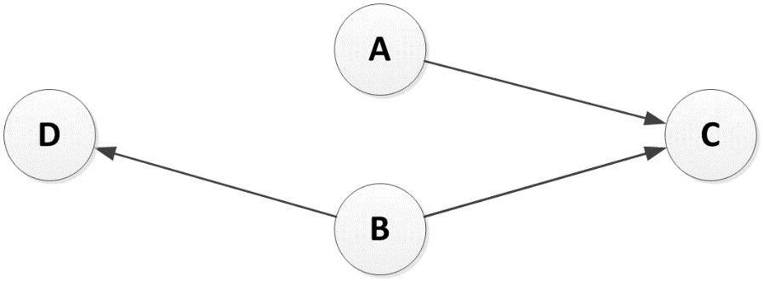
Collaborative Filtering: Illustration
A and B are following C, and B is following D
A might be interested in following D

Slide 43

Measure Similarity between Users / Items)
Cosine Similarity
Pearson Correlation Coefficient
Notes:
Can we use Jaccard index J(A,B) = |A^B|/|AvB|

Slide 44
User-based Collaborative Filtering
In user-based collaborative filtering, the system finds the most similar user (users) to the current user and uses their preferences for recommendation
The user-based approach is not as popular as the item-based approach
For a system that handles a large user base, even the smallest change in the user data is likely to reset the entire group of similar users

Slide 45
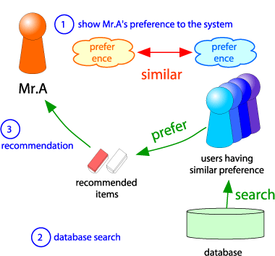
Collaborative Filtering
Consider user x
Find set N of other users whose ratings are “similar” to x’s ratings
Estimate x’s ratings based on ratings of users in N
x
N

Slide 46
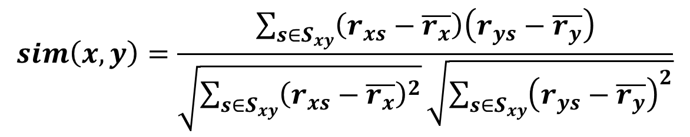
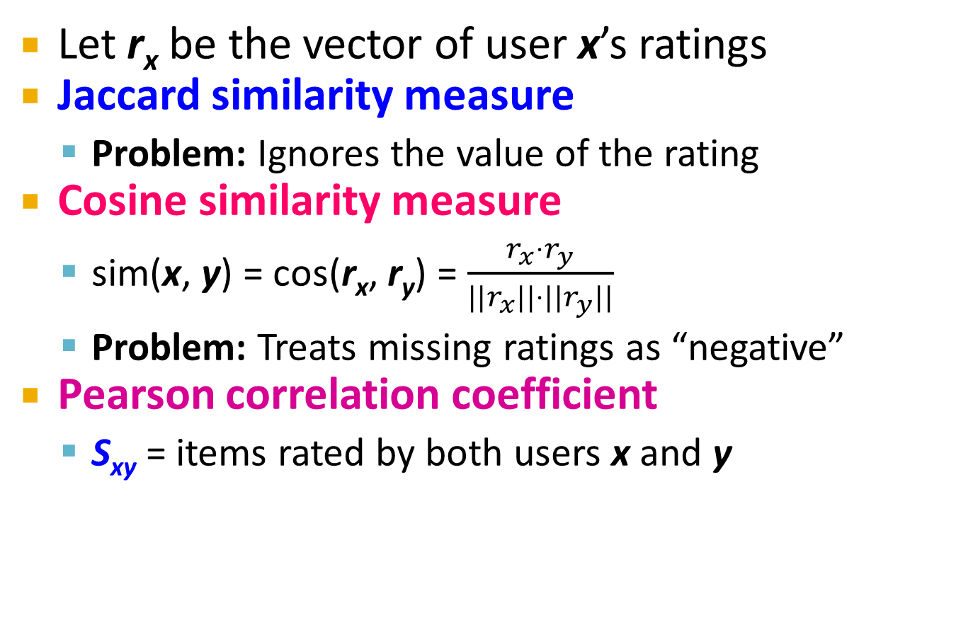
Finding “Similar” Users
r_{x} = [*, _, _, *, ***]
r_{y} = [*, _, **, **, _]
Let r_{x} be the vector of user x’s ratings
Jaccard similarity measure
Problem: Ignores the value of the rating
Cosine similarity measure
sim(x, y) = cos(r_{x}, r_{y}) = $\frac{r_{x}⋅r_{y}}{||r_{x}||⋅{||r}_{y}||}$
Problem: Treats missing ratings as “negative”
Pearson correlation coefficient
S_{xy} = items rated by both users x and y
r_{x}, r_{y} as sets:
r_{x} = {1, 4, 5}
r_{y} = {1, 3, 4}
r_{x}, r_{y} as points:
r_{x} = {1, 0, 0, 1, 3}
r_{y} = {1, 0, 2, 2, 0}
$$sim\left(x,y\right)=\frac{\sum_{s∈S_{xy}}{\left(r_{xs}−\overline{r_{x}}\right)\left(r_{ys}−\overline{r_{y}}\right)}}{\sqrt{\sum_{s∈S_{xy}}{{\left(r_{xs}−\overline{r_{x}}\right)}^{2}}}\sqrt{\sum_{s∈S_{xy}}{{\left(r_{ys}−\overline{r_{y}}\right)}^{2}}}}$$
r_{x}, r_{y} … avg. rating of x, y
Notes:
-- Jaccard is not appropriate as we want to consider weights

Slide 47
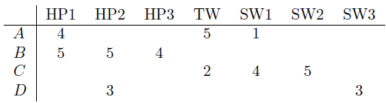
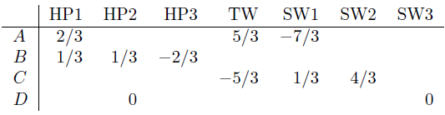

Similarity Metric
Cosine sim:
$$sim(x, y) = \frac{\sum_{i}{r_{xi}⋅r_{yi}}}{\sqrt{\sum_{i}{r_{xi}^{2}}}⋅\sqrt{\sum_{i}{r_{yi}^{2}}}}$$
Intuitively we want: sim(A, B) > sim(A, C)
Jaccard similarity: 1/5 < 2/4
Cosine similarity: 0.386 > 0.322
Considers missing ratings as “negative”
Solution: subtract the (row) mean
sim A,B vs. A,C:
0.092 > -0.559
Notice cosine sim. is correlation when data is centered at 0

Slide 48
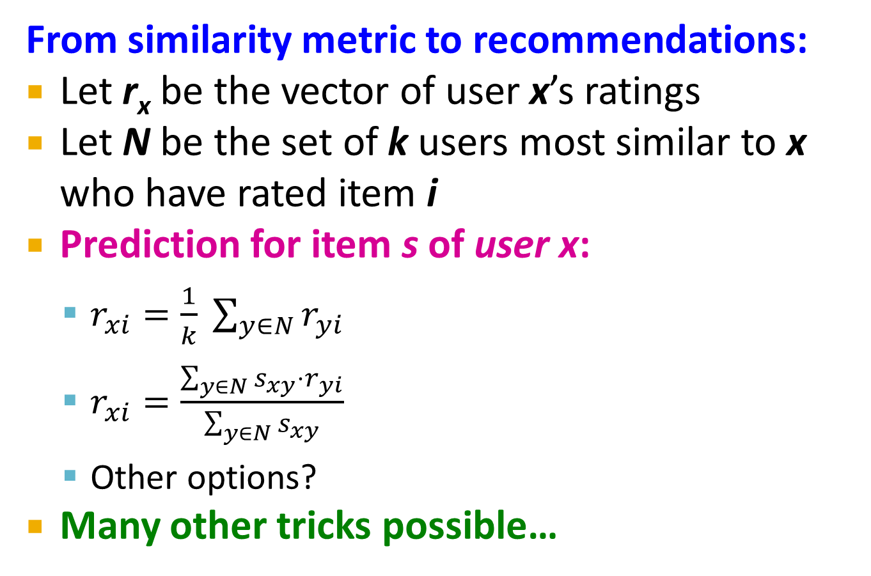
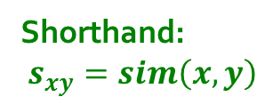
Rating Predictions
From similarity metric to recommendations:
Let r_{x} be the vector of user x’s ratings
Let N be the set of k users most similar to x who have rated item i
Prediction for item s of user x:
$r_{xi}=\frac{1}{k} \sum_{y∈N}{r_{yi}}$
$r_{xi}=\frac{\sum_{y∈N}{s_{xy}⋅r_{yi}}}{\sum_{y∈N}{s_{xy}}}$
Other options?
Many other tricks possible…
Shorthand: $s_{xy}=sim\left(x,y\right)$

Slide 49
User-based CF
Updating the ratings:
User v’s mean rating
User u‘s mean rating
Observed rating of user v for item i
Predicted rating of user u for item i

Slide 50
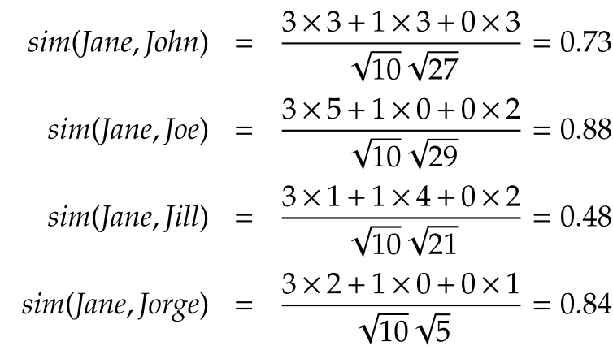
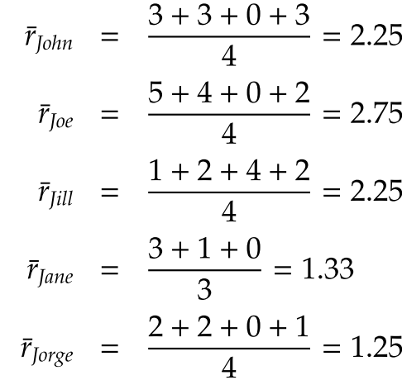
User-based CF, Example
Predict Jane’s rating for Aladdin
1- Calculate average ratings
2- Calculate user-user similarity
Notes:
Predict Jane’s rating for Aladdin

Slide 51
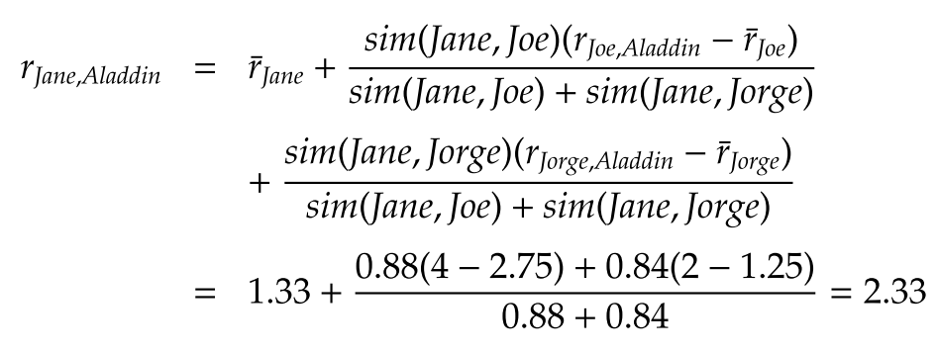
User-based CF, Example- continued
3- Calculate Jane’s rating for Aladdin,
Assume that neighborhood size = 2

Slide 52
Item-Item Collaborative Filtering
Another view: Item-item
For item i, find other similar items
Estimate rating for item i based on ratings for similar items
Can use same similarity metrics and prediction functions as in user-user model
s_{ij}… similarity of items i and j
r_{xj}…rating of user u on item j
N(i;x)… set items rated by x similar to i

Slide 53
Item-based CF
Calculate the similarity between items and then predict new items based on the past ratings for similar items
Item i’s mean rating
i and j are two items

Slide 54
Item-Item CF (|N|=2)
users
12 | 11 | 10 | 9 | 8 | 7 | 6 | 5 | 4 | 3 | 2 | 1
 | 4 |  | 5 |  |  | 5 |  |  | 3 |  | 1 | 1
3 | 1 | 2 |  |  | 4 |  |  | 4 | 5 |  |  | 2
 | 5 | 3 | 4 |  | 3 |  | 2 | 1 |  | 4 | 2 | 3
 | 2 |  |  | 4 |  |  | 5 |  | 4 | 2 |  | 4
5 | 2 |  |  |  |  | 2 | 4 | 3 | 4 |  |  | 5
 | 4 |  |  | 2 |  |  | 3 |  | 3 |  | 1 | 6
movies
- unknown rating
- rating between 1 to 5

Slide 55
Item-Item CF (|N|=2)
users
12 | 11 | 10 | 9 | 8 | 7 | 6 | 5 | 4 | 3 | 2 | 1
 | 4 |  | 5 |  |  | 5 | ? |  | 3 |  | 1 | 1
3 | 1 | 2 |  |  | 4 |  |  | 4 | 5 |  |  | 2
 | 5 | 3 | 4 |  | 3 |  | 2 | 1 |  | 4 | 2 | 3
 | 2 |  |  | 4 |  |  | 5 |  | 4 | 2 |  | 4
5 | 2 |  |  |  |  | 2 | 4 | 3 | 4 |  |  | 5
 | 4 |  |  | 2 |  |  | 3 |  | 3 |  | 1 | 6
movies
- estimate rating of movie 1 by user 5

Slide 56
Item-Item CF (|N|=2)
users
12 | 11 | 10 | 9 | 8 | 7 | 6 | 5 | 4 | 3 | 2 | 1
 | 4 |  | 5 |  |  | 5 | ? |  | 3 |  | 1 | 1
3 | 1 | 2 |  |  | 4 |  |  | 4 | 5 |  |  | 2
 | 5 | 3 | 4 |  | 3 |  | 2 | 1 |  | 4 | 2 | 3
 | 2 |  |  | 4 |  |  | 5 |  | 4 | 2 |  | 4
5 | 2 |  |  |  |  | 2 | 4 | 3 | 4 |  |  | 5
 | 4 |  |  | 2 |  |  | 3 |  | 3 |  | 1 | 6
sim(1,m)
1.00
-0.18
0.41
-0.10
-0.31
0.59
movies
Neighbor selection: Identify movies similar to movie 1, rated by user 5
Here we use Pearson correlation as similarity:
1) Subtract mean rating m_{i} from each movie i m₁ = (1+3+5+5+4)/5 = 3.6 row 1: [-2.6, 0, -0.6, 0, 0, 1.4, 0, 0, 1.4, 0, 0.4, 0]
2) Compute cosine similarities between rows

Slide 57
Item-Item CF (|N|=2)
users
12 | 11 | 10 | 9 | 8 | 7 | 6 | 5 | 4 | 3 | 2 | 1
 | 4 |  | 5 |  |  | 5 | ? |  | 3 |  | 1 | 1
3 | 1 | 2 |  |  | 4 |  |  | 4 | 5 |  |  | 2
 | 5 | 3 | 4 |  | 3 |  | 2 | 1 |  | 4 | 2 | 3
 | 2 |  |  | 4 |  |  | 5 |  | 4 | 2 |  | 4
5 | 2 |  |  |  |  | 2 | 4 | 3 | 4 |  |  | 5
 | 4 |  |  | 2 |  |  | 3 |  | 3 |  | 1 | 6
sim(1,m)
1.00
-0.18
0.41
-0.10
-0.31
0.59
movies
Compute similarity weights: s_{1,3}=0.41, s_{1,6}=0.59

Slide 58
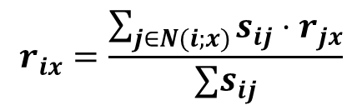
Item-Item CF (|N|=2)
users
12 | 11 | 10 | 9 | 8 | 7 | 6 | 5 | 4 | 3 | 2 | 1
 | 4 |  | 5 |  |  | 5 | 2.6 |  | 3 |  | 1 | 1
3 | 1 | 2 |  |  | 4 |  |  | 4 | 5 |  |  | 2
 | 5 | 3 | 4 |  | 3 |  | 2 | 1 |  | 4 | 2 | 3
 | 2 |  |  | 4 |  |  | 5 |  | 4 | 2 |  | 4
5 | 2 |  |  |  |  | 2 | 4 | 3 | 4 |  |  | 5
 | 4 |  |  | 2 |  |  | 3 |  | 3 |  | 1 | 6
movies
Predict by taking weighted average:
r_{1.5} = (0.41*2 + 0.59*3) / (0.41+0.59) = 2.6
$$r_{ix}=\frac{\sum_{j∈N(i;x)}{s_{ij}⋅r_{jx}}}{∑s_{ij}}$$

Slide 59

CF: Common Practice
Before:
Define similarity s_{ij} of items i and j
Select k nearest neighbors N(i; x)
Items most similar to i, that were rated by x
Estimate rating r_{xi} as the weighted average:
baseline estimate for r_{xi}
μ = overall mean movie rating
b_{x} = rating deviation of user x
= (avg. rating of user x) – μ
b_{i} = rating deviation of movie i
$$b_{xi}=μ+b_{x}+b_{i}$$

Slide 60
Item-Item vs. User-User
Avatar
LOTR
Matrix
Pirates
Alice
Bob
Carol
David
In practice, it has been observed that item-item often works better than user-user
Why? Items are simpler, users have multiple tastes
Notes:
There is a difference in the typical behavior of users and items, as it
pertains to similarity. Intuitively, items tend to be classifiable in simple
terms. For example, music tends to belong to a single genre. It is impossi-
ble, e.g., for a piece of music to be both 60’s rock and 1700’s baroque. On
the other hand, there are individuals who like both 60’s rock and 1700’s
baroque, and who buy examples of both types of music.
The consequence is that it is easier to discover items that are similar because they belong
to the same genre, than it is to detect that two users are similar because
they prefer one genre in common, while each also likes some genres that
the other doesn’t care for.

Slide 61
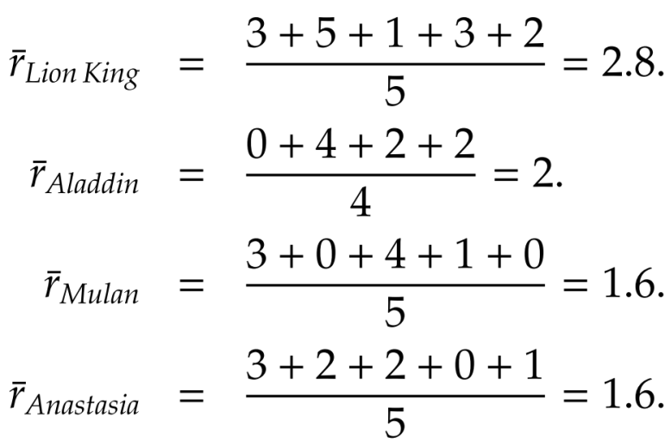
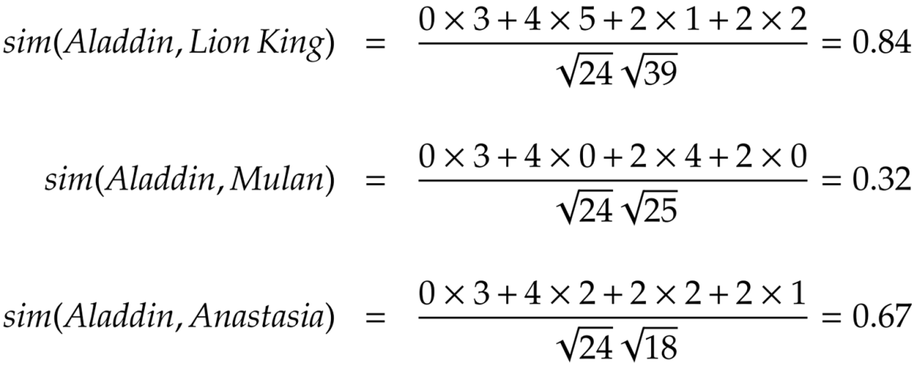
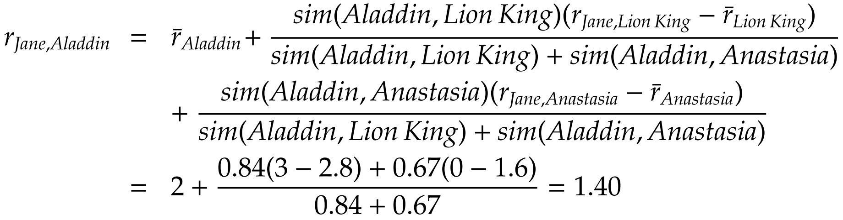
Item-based CF, Example
1- Calculate average ratings
2- Calculate item-item similarity
3- Calculate Jane’s rating for Aladdin, Assume that neighborhood size = 2

Slide 62
Pros/Cons of Collaborative Filtering
+ Works for any kind of item
No feature selection needed
- Cold Start:
Need enough users in the system to find a match
- Sparsity:
The user/ratings matrix is sparse
Hard to find users that have rated the same items
- First rater:
Cannot recommend an item that has not been previously rated
New items, Esoteric items
- Popularity bias:
Cannot recommend items to someone with unique taste
Tends to recommend popular items

Slide 63
Collaborative Filtering: Complexity
Expensive step is finding k most similar customers: O(|X|)
Too expensive to do at runtime
Could pre-compute
Naïve pre-computation takes time O(k ·|X|)
X … set of customers
We already know how to do this!
Near-neighbor search in high dimensions (LSH)
Clustering
Dimensionality reduction

Slide 64
Hybrid Methods
Implement two or more different recommenders and combine predictions
Perhaps using a linear model
Add content-based methods to collaborative filtering
Item profiles for new item problem
Demographics to deal with new user problem

